Slide 1
AI DIETITIAN
NEHA GILBILE
ALTAF SAYAD
SAURABH YADAV

Slide 2
INTRODUCTION :
Smart phones and the Internet have revolutionized the communication and with it the lifestyle of people. An increasing number of smart phones and Personal Digital Assistants (PDA) allow people to access the Internet where ever they are and whenever they want.
Artificial dietitian is an application with artificial intelligence about human diets. It acts as a diet consultant similar to a real dietian .
This system acts in a similar way as that of a dietitian .A Person in order to know his/her diet plans needs to give some information to the dietitian such as its body type, weight, height, and working hour details.

Slide 3
LITERATURE SURVEY :
EXISTING SYSTEM :
Dietitian and user have to consult each other directly if any information is needed. If any new user come for diet schedule, dietitian and his staff has to search the user details and they have to find the dietitian schedule for that particular diet. Here searching for eligible diet takes lots of time. And sometimes some users’ details may be missed.
1. According to current health survey in India there are more then 70% of people suffer from one or the other disease.
2. This is because they don’t know how much they should eat.
3. People avoid going to nutritionists or diet planner because of their high fees.
4. Unaware of amount of fat required by body.

Slide 4
PROPOSED SYSTEM :
“Artificial Intelligence Dietitian” is a BOT with artificial intelligence about human diets.
It acts as a diet consultant similar to a real Dietitian
User may log in and view various diet information
A Dietitian consults a person based on his schedule, body type, height and weight. The system too asks all this data from the user and processes it.

Slide 5
FEATURES :
Load Balancing
Easy Accessibility
User Friendly
Efficient and reliable
Easy maintenance

Slide 6
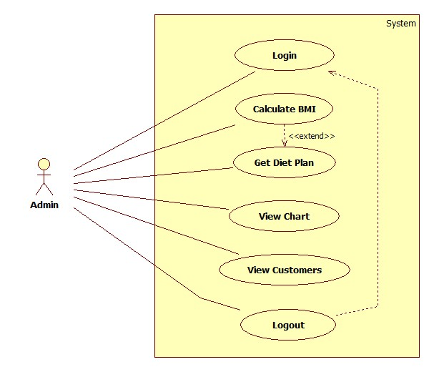
- USE CASE DIAGRAM OF ADMIN

Slide 7
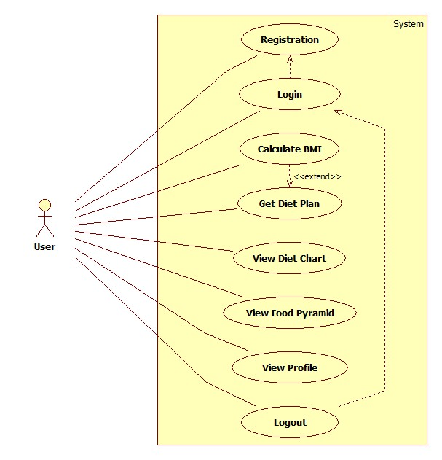
- USE CASE DIAGRAM OF USER

Slide 8
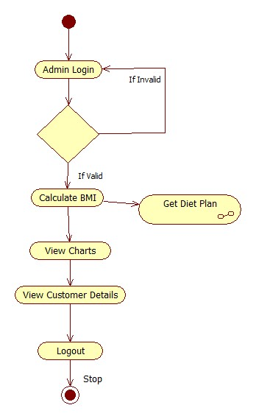
ACTIVITY DIAGRAM: (ADMIN)

Slide 9
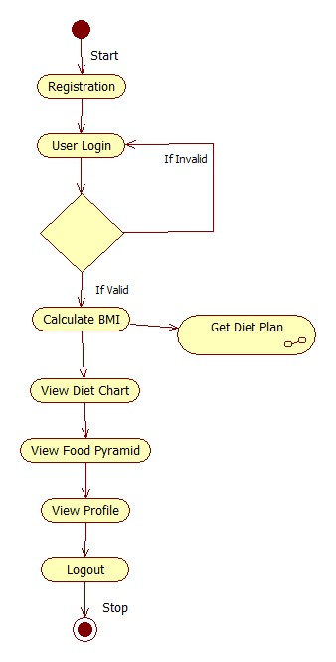
ACTIVITY DIAGRAM : (USER)

Slide 10
Hardware & Software
Hardware Requirements
Processor –Core i3
Hard Disk – 500 GB
Memory –4 GB RAM (Minimum)
Monitor
Software Requirements
Windows 7 or higher
Java
JDK
Firebase
Android Studio

Slide 11
Future Scope
The project is easily extensible and can be improved by further incremental releases Of the same. We plan to focus on improving the overall performance of the system. Also, interaction between guider and dietitian through video calling and secure prescription will be focused upon. Some more ways to achieve dietitian will be focused.

Slide 12
Conclusion
Our approach for implementing this project is we have implemented the artificial intelligent dietitian using android. Our system comprises of main components such as of a user login and an admin login. The software system allows the user to create their profiles and upload all their details including their BMI onto the system. The admin can check each user details and can remove faulty accounts. The system also consists of a diet plan for the users.

